Slide 1
Radium Sorption Results
Michael Chen
Group meeting 4/8/2016

Slide 2
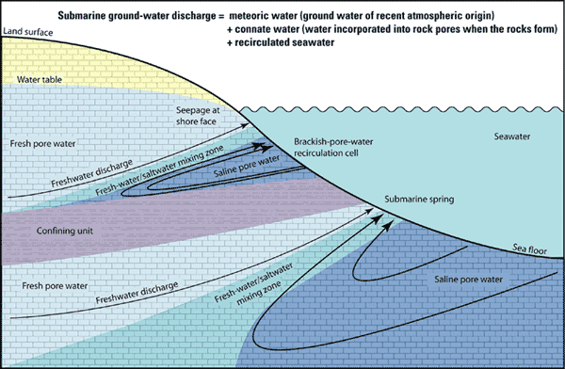
Figure depicting components of SGD:https://walrus.wr.usgs.gov/sgd/overview.html

Slide 3
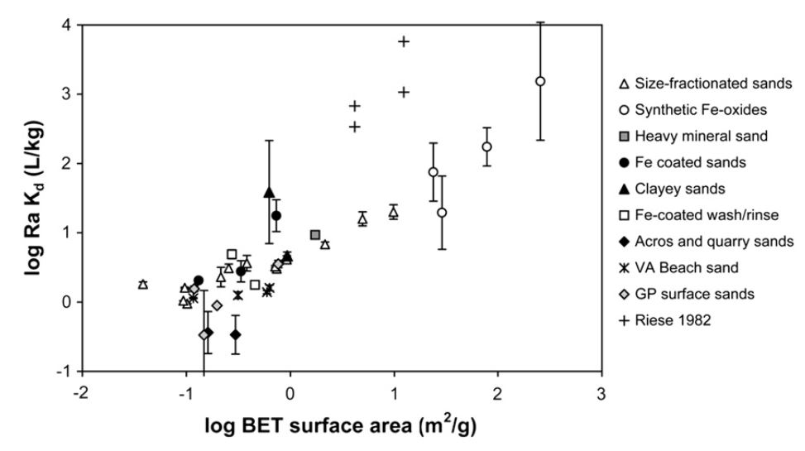
Radium sorption to marine sands in seawater from Beck & Cochran, 2013

Slide 4
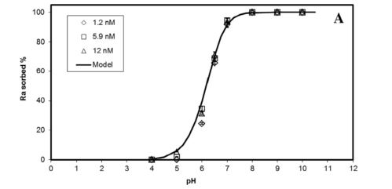
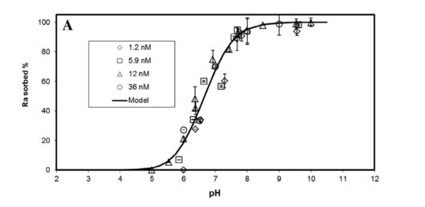
Ferrihydrite 0.1 g in 10 mL NaClO4
10-100 Bq/mL total Radium 226
Goethite 0.1 g in 10 mL NaClO4
From Sajih et al., 2014

Slide 5
Isotherm Parameters
10 mM NaCl solution
0.03 g in 100 mL solution
0.1-5 Bq/mL total Radium 226

Slide 6
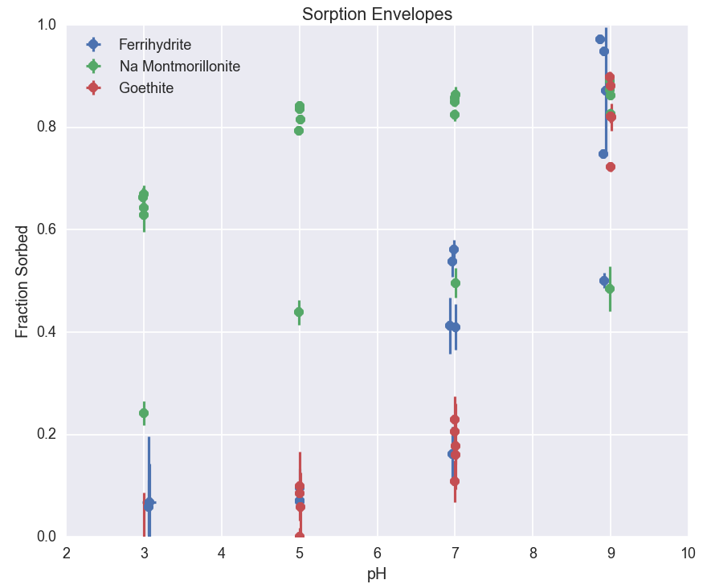

Slide 7
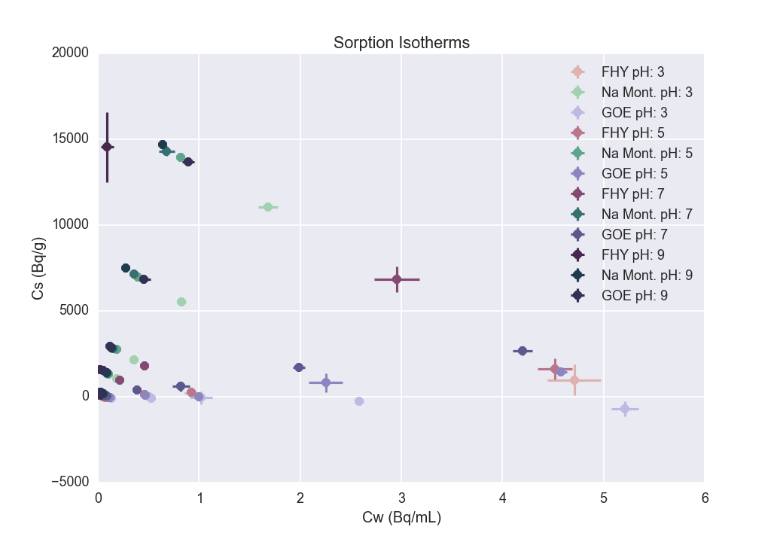

Slide 8
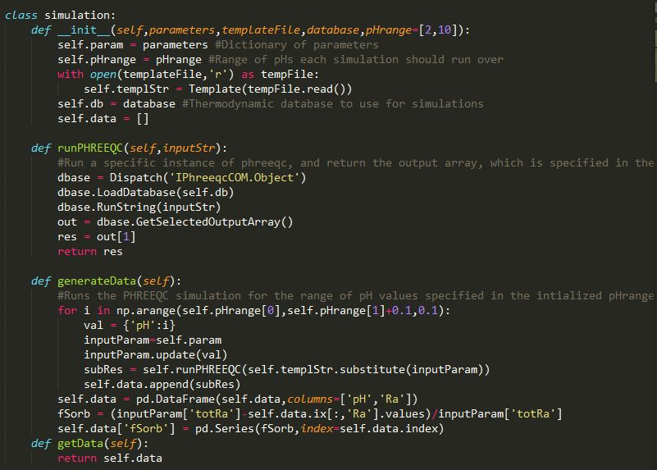
Surface Complexation with PHREEQC and Python

Slide 9
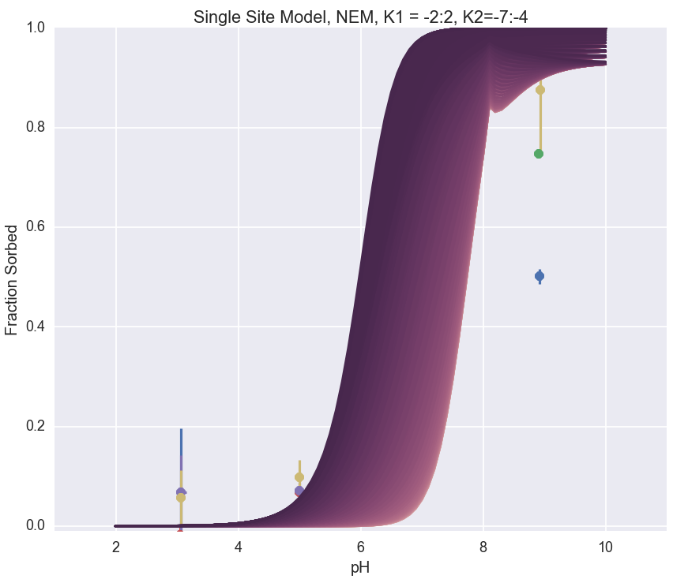

Slide 10
